Slide 1
Space Weather Modeling & CGS Intro
An Adapted Presentation Originally given on/by:
9-10 November 2020
cgs.jhuapl.edu/workshop
-Slava Merkin (PI of CGS), JHU/APL
June 7th, 2024
Tristen D. Wanner
Graduate Research Assistant
Virginia Tech. SuperDARN Lab
wtristen@vt.edu

Slide 2
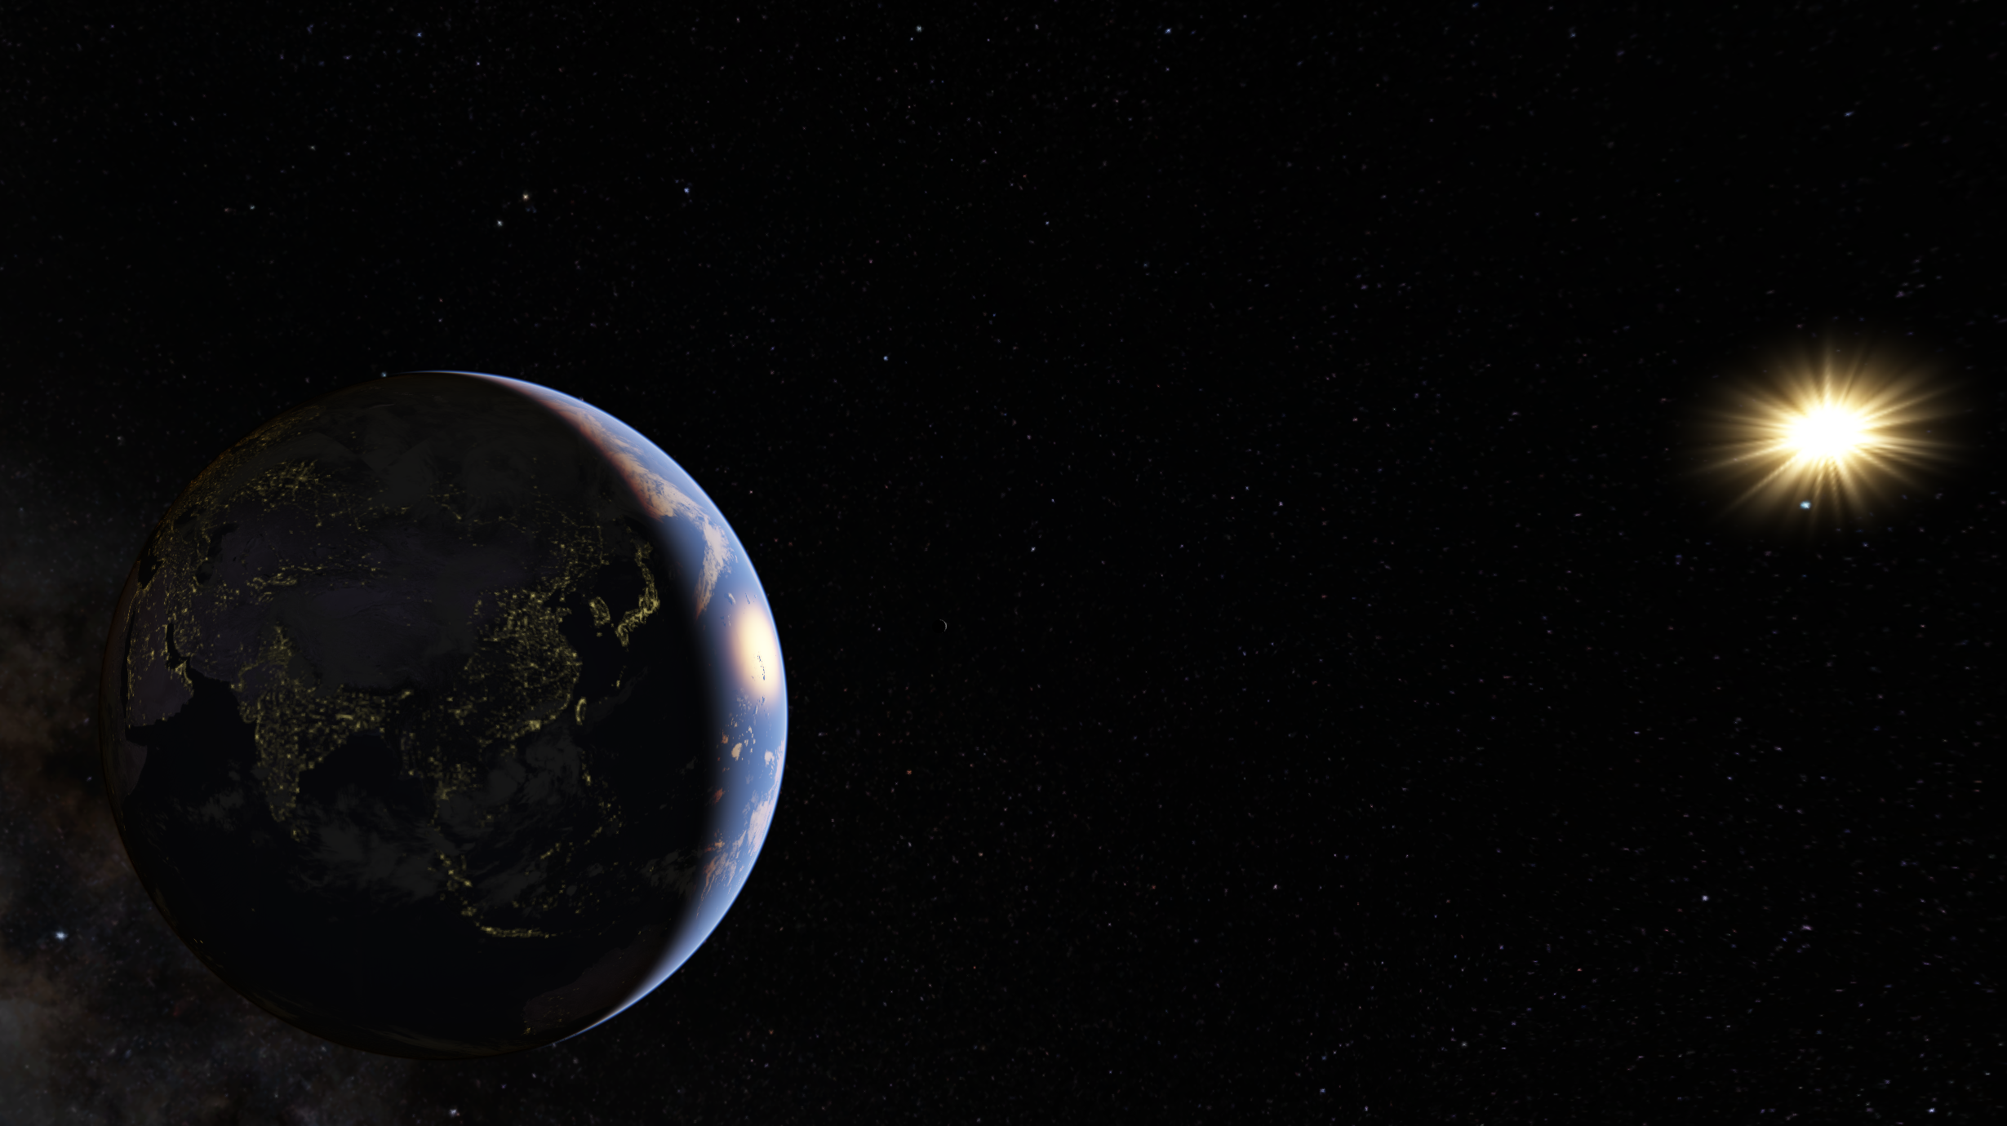

What are we trying to accomplish
with modeling?

Slide 3
Well, geospace isn’t quite as simple as this picture implies…

Slide 4
In fact, it’s quite complicated! And we want to develop a new way to help study it.

Slide 5
One challenge is that it’s multi-scale and multi-physics
Understanding the physics of geospace, particularly during strong disturbances, requires describing it in its entirety
That is an incredibly complex problem, and so is predicting space weather
A multitude of plasma and neutral populations coexist and interact strongly with each other and EM fields across scales and domains
All these interactions should be included in a predictive model
Mesoscales are important. Must be resolved because they lead to "emergent" global behavior.
-Slava Merkin (PI of CGS), JHU/APL

Slide 6
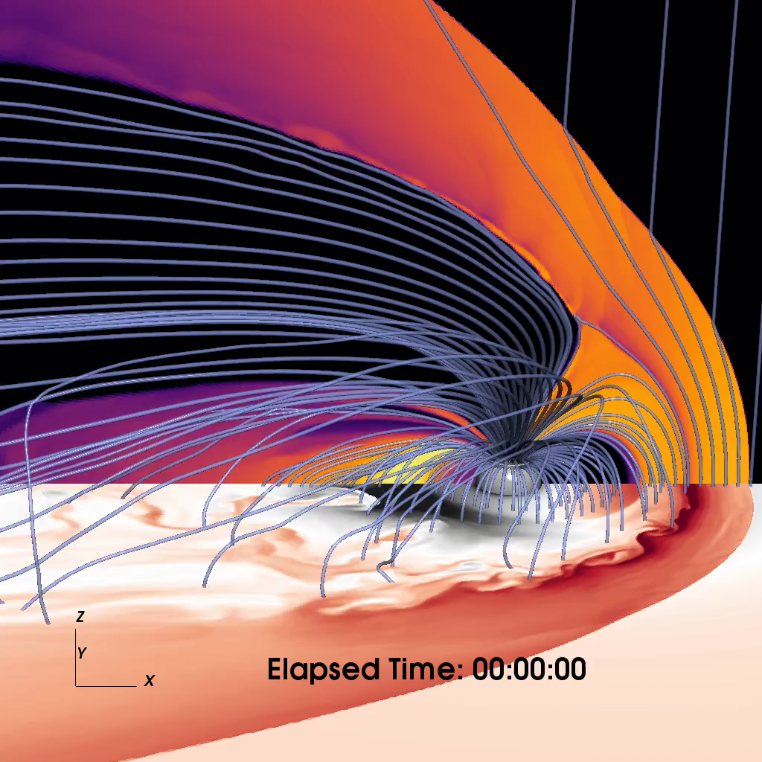
Magnetosphere: 1-300 Re
Notes:
Multiscale plasma sheet transport, ring current build-up, and their global impacts throughout stormtime geospace
How is plasma and electromagnetic energy transported through the plasma sheet to the ring current at different spatiotemporal scales?
How do plasma sheet dynamics at different spatiotemporal scales control energy deposition and momentum transfer from the magnetosphere to the ionosphere-thermosphere, and what are the corresponding global geospace impacts?

Slide 7
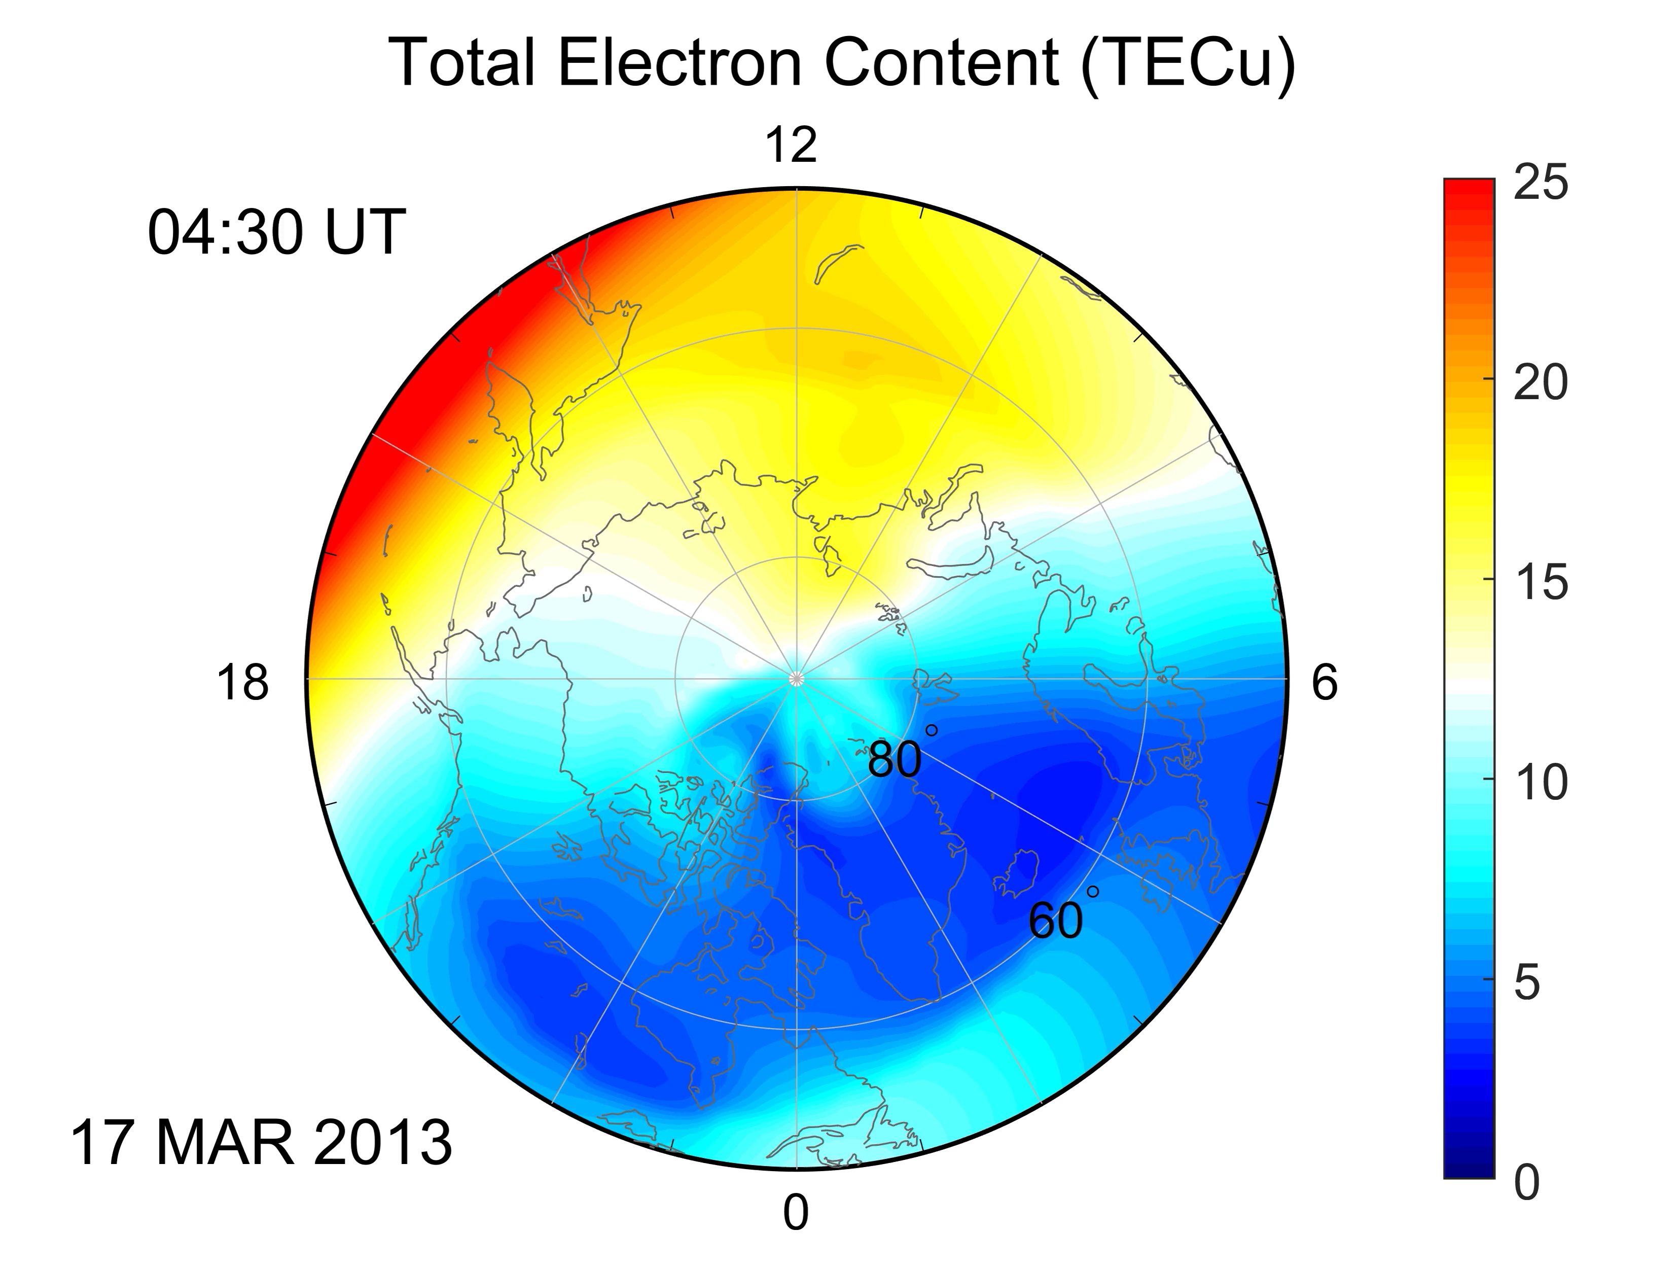
Ionosphere-Thermosphere: 70-1,000 km

Slide 8
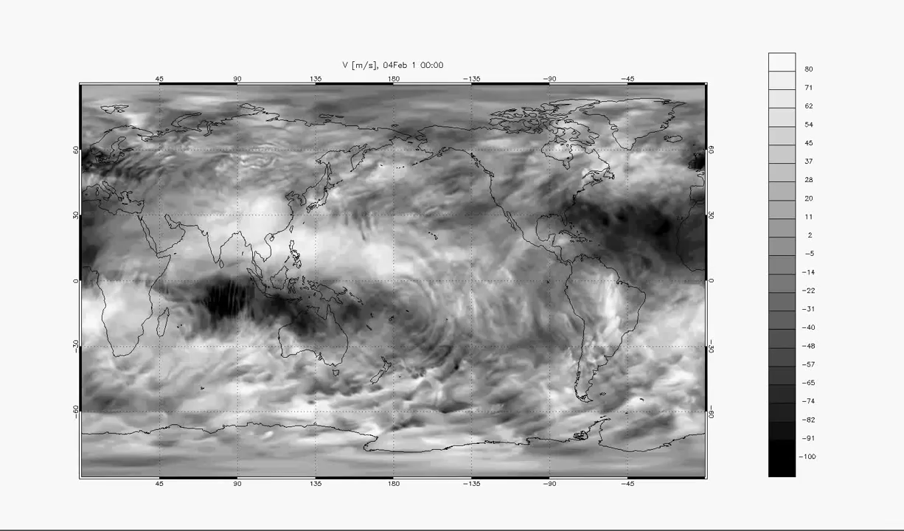
Lower Atmosphere: 0-70 km

Slide 9
There are so many variables and questions yet to be answered:
Science Themes:
  Multiscale plasma sheet transport, ring current build-up, and their global impacts throughout storm-time geospace
  Storm-time mesoscale ionospheric structure and global geospace mass circulation
  Lower atmosphere-ionosphere-magnetosphere coupling at different scales

Slide 10
There are so many variables and questions yet to be answered:
Questions we’re researching:
Science Themes:
  Multiscale plasma sheet transport, ring current build-up, and their global impacts throughout storm-time geospace
  Storm-time mesoscale ionospheric structure and global geospace mass circulation
  Lower atmosphere-ionosphere-magnetosphere coupling at different scales
How is plasma and electromagnetic energy transported through the plasma sheet to the ring current at different spatiotemporal scales?
How do plasma sheet dynamics at different spatiotemporal scales control energy deposition and momentum transfer from the magnetosphere to the ionosphere-thermosphere, and what are the corresponding global geospace impacts?

Slide 11
There are so many variables and questions yet to be answered:
Questions we’re researching:
Science Themes:
  Multiscale plasma sheet transport, ring current build-up, and their global impacts throughout storm-time geospace
  Storm-time mesoscale ionospheric structure and global geospace mass circulation
  Lower atmosphere-ionosphere-magnetosphere coupling at different scales
How do high-latitude energy deposition and momentum transfer engender mass circulation throughout the ionosphere-thermosphere at different spatiotemporal scales?
What are the global impacts of mass circulation throughout geospace and its origins in mesoscale ionospheric structure and dynamics?

Slide 12
There are so many variables and questions yet to be answered:
Questions we’re researching:
Science Themes:
  Multiscale plasma sheet transport, ring current build-up, and their global impacts throughout storm-time geospace
  Storm-time mesoscale ionospheric structure and global geospace mass circulation
  Lower atmosphere-ionosphere-magnetosphere coupling at different scales
How does the interplay between magnetosphere and lower atmosphere forcing regulate the formation and evolution of equatorial plasma bubbles?
How do lower atmosphere waves change during storms and how significant are their effects on geospace responses to storms through preconditioning?

Slide 13
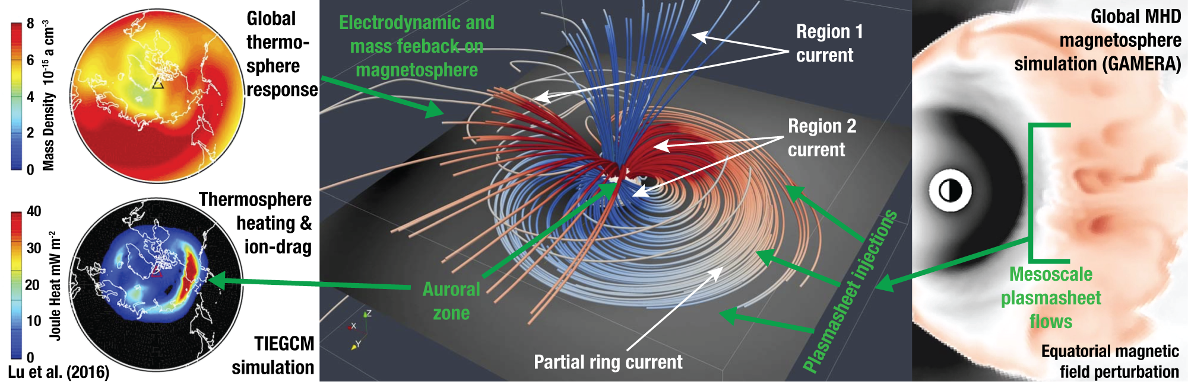
An example of a Mesoscale (1-3 Re) processes with global-scale consequences:
Bursty bulk flows & build-up of the ring current
Gkioulidou et al., (2014); Yang et al., (2015); Cramer et al. (2017)

Slide 14
An example of a Mesoscale processes with global-scale consequences:
Bursty bulk flows & build-up of the ring current
These localized, intermittent flows are generated at the magnetotail, and they travel Earthward, possibly leading to a large amount of plasma and magnetic flux transport.

Slide 15
An example of a Mesoscale processes with global-scale consequences:
Bursty bulk flows & build-up of the ring current
They are also believed to contribute significantly to the formation of the ring current via injection of energetic ions into the inner magnetosphere.

Slide 16
An example of a Mesoscale processes with global-scale consequences:
Bursty bulk flows & build-up of the ring current
The ring current, in turn, drives the so-called "Region 2" magnetic field-aligned currents into the ionosphere where they connect to the "Region 1" currents driven by magnetospheric processes at higher latitudes.

Slide 17
An example of a Mesoscale processes with global-scale consequences:
Bursty bulk flows & build-up of the ring current
The currents then form a feedback loop in the ionosphere which occurs across ‘electrojets’, which are the most intense electrical currents in the ionosphere. It is in these auroral regions where strong Joule heating and momentum transfer between the ions and neutrals occur.

Slide 18
An example of a Mesoscale processes with global-scale consequences:
Bursty bulk flows & build-up of the ring current
As a storm develops, the thermosphere is significantly stirred up, and changes in high-latitude neutral temperature and winds are transmitted to lower latitudes through non-linear, coupled dynamical processes, causing global-scale variations in neutral temperature, winds and composition.

Slide 19
An example of a Mesoscale processes with global-scale consequences:
Bursty bulk flows & build-up of the ring current
All this results in complex storm-time ionospheric conductivity changes that enforce electrodynamic feedback on the magnetosphere and an upwelling of ionospheric ions which then flow out into the magnetosphere.

Slide 20
An example of a Mesoscale processes with global-scale consequences:
Bursty bulk flows & build-up of the ring current
In the storm recovery phase, the large inertia of neutrals keeps driving wind-generated currents, providing feedback on the magnetosphere for hours.

Slide 21
Clearly, this is quite a complex system demonstrating how a mesoscale process (the bursty bulk flows) can have global-scale consequences.

Slide 22
Simulating this complex chain of coupled phenomena demands incorporation of all the involved domains, while resolving both the physics and the spatiotemporal scales of the key processes at play.

Slide 23
This is where the Center for Geospace Storms comes in…

Slide 24
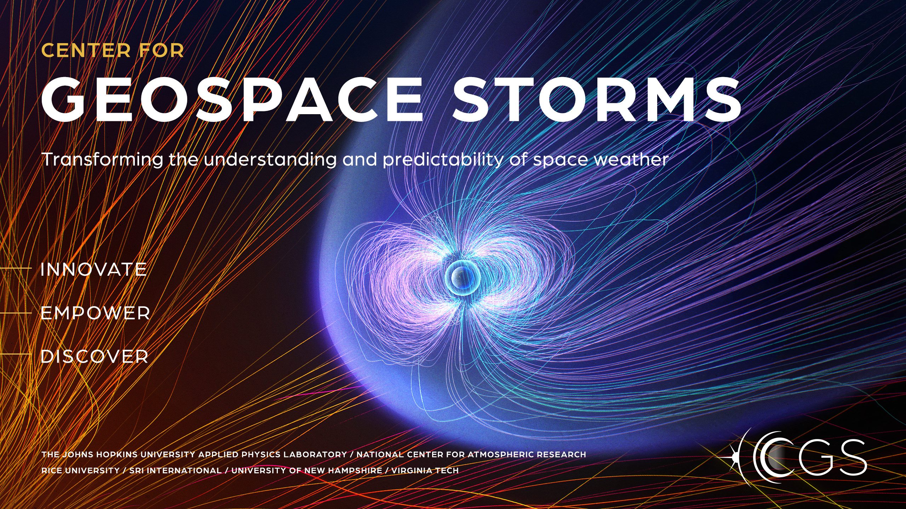

Slide 25
INNOVATE community modeling capabilities by building a physics-based, predictive model of storm-time geospace, coupling all key regions and resolving critical mesoscale processes.
We call the whole geospace model we will build the Multiscale Atmosphere-Geospace Environment (MAGE) model.

Slide 26
EMPOWER the MAGE model incorporating diverse data sources and implementing robust validation methods using multiple types of data.

Slide 27
DISCOVER, understand, and quantify the causal connections and emergent dynamics across spatiotemporal scales, domains, species, and energy populations characteristic of storm-time geospace.
Injection of plasmasheet particles into the ring current by bursty bulk flows
Ionospheric polar cap patches and tongues of ionization
Driving/preconditioning of the ionosphere-thermosphere by lower atmospheric waves and disturbances.

Slide 28
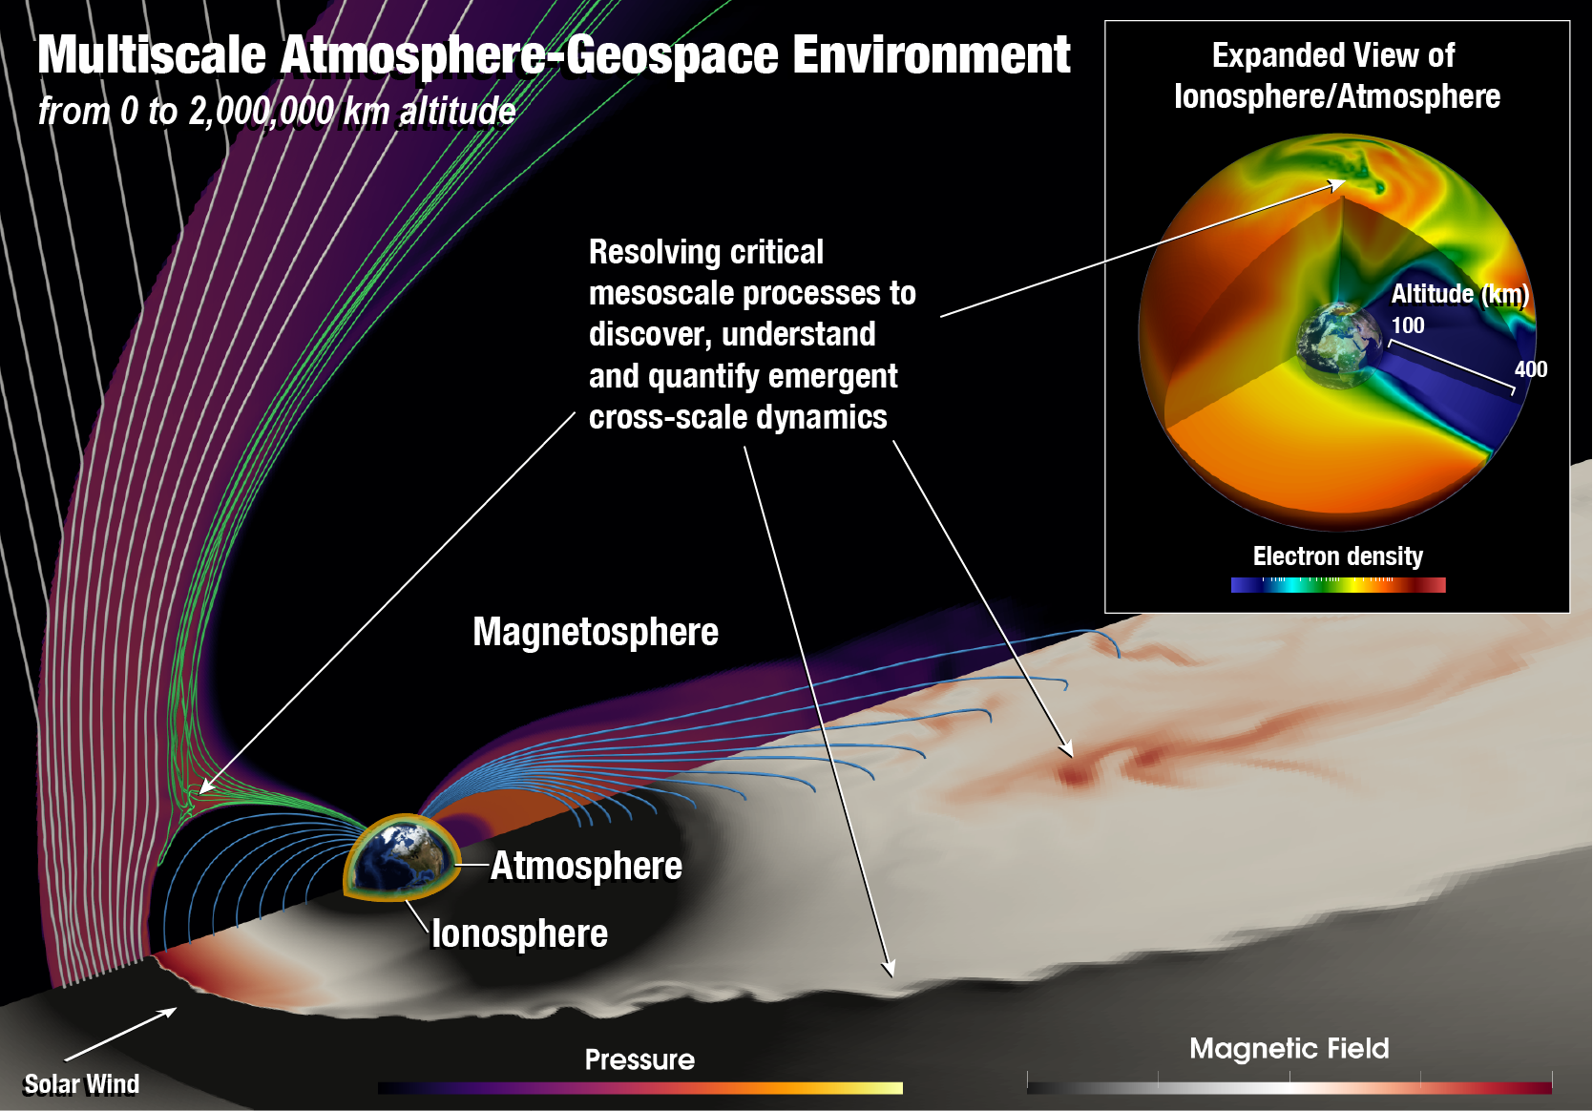

MAGE fulfills two key requirements:
Describe the Geospace-Atmosphere system holistically.
Resolve critical mesoscale processes in all relevant domains.
cgs.jhuapl.edu/Models

Slide 29
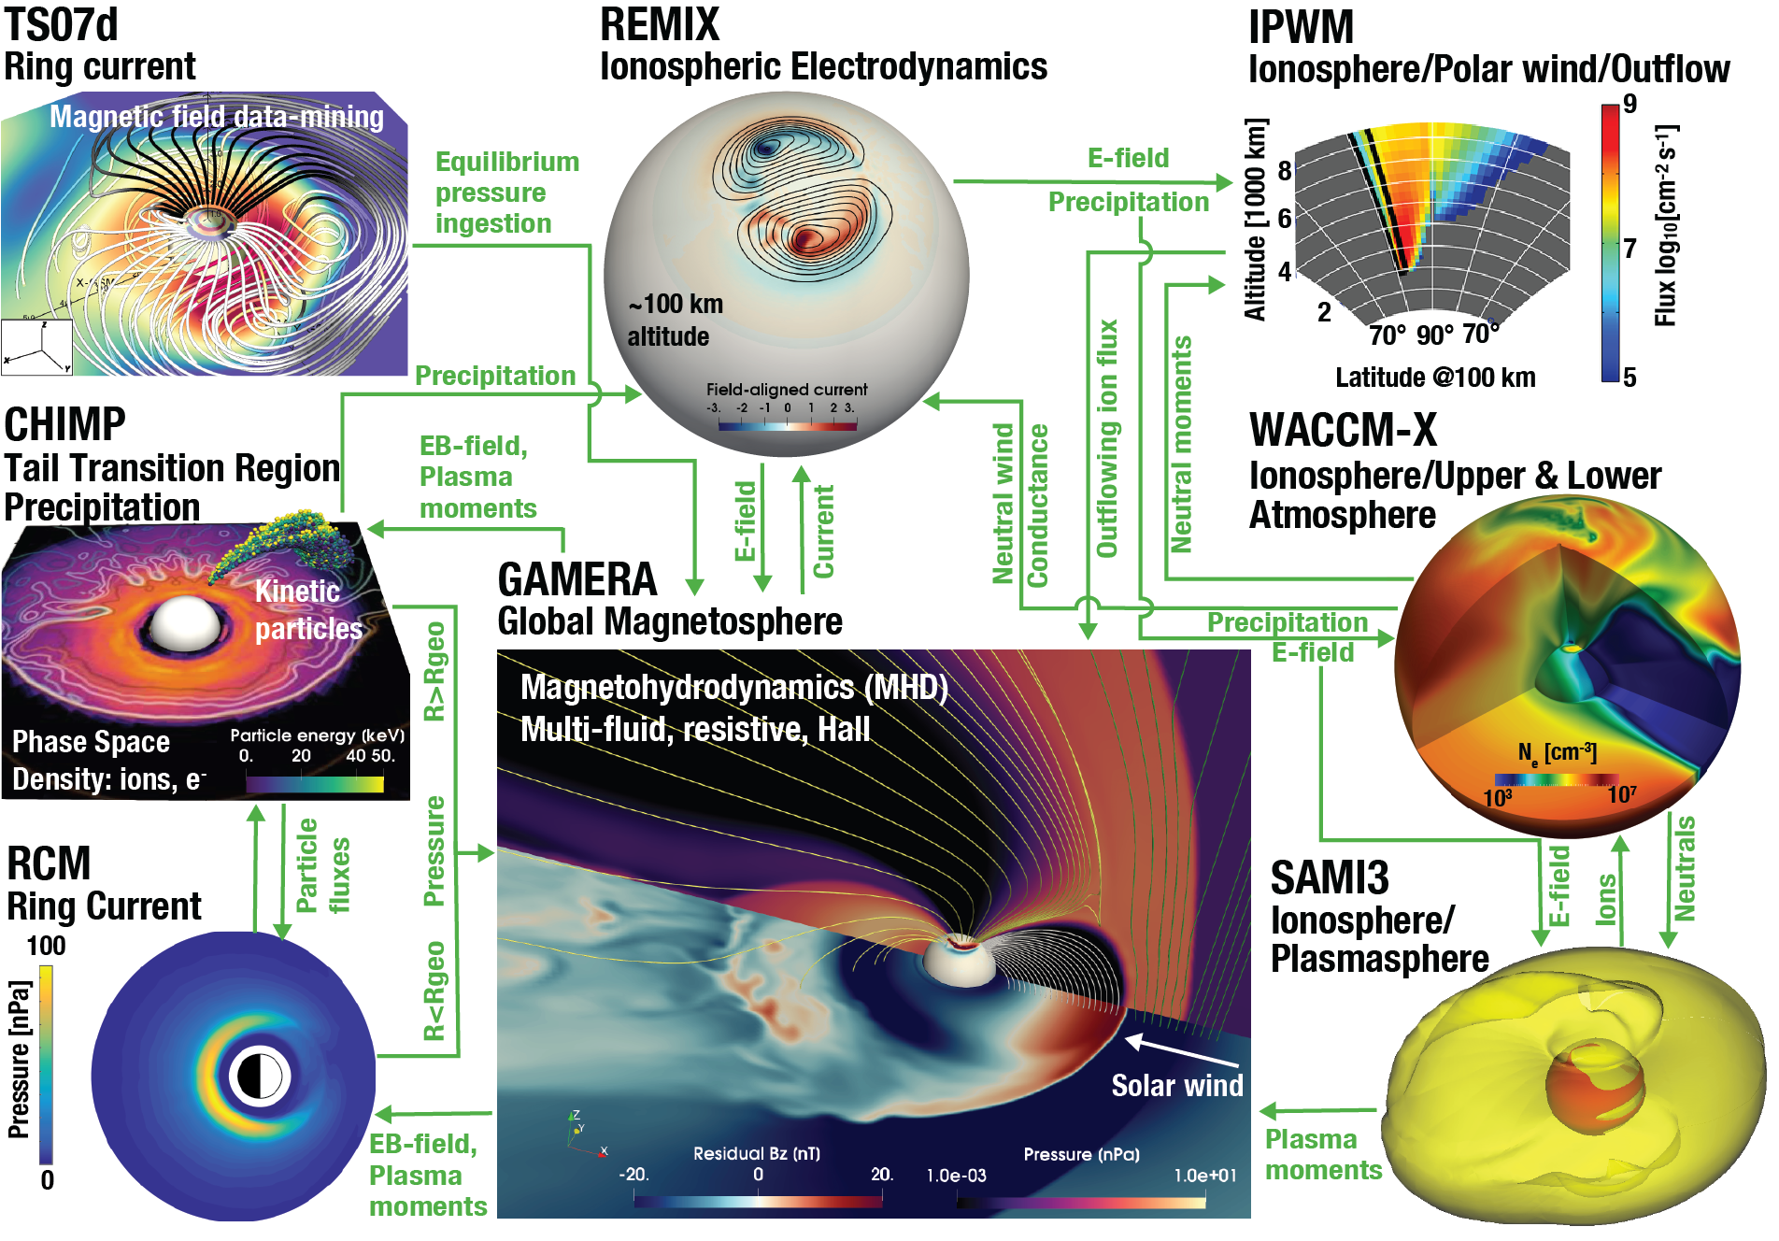



The MAGE Vision
Multiscale Atmosphere-Geospace Environment

Slide 30
The MAGE Vision
Multiscale Atmosphere-Geospace Environment
GAMERA+RCM+TIEGCM = MAGE 1.0
fully coupled as part of CGS Phase I.
Just released MAGE 0.75 to the CCMC!
TIEGCM

